Slide 1

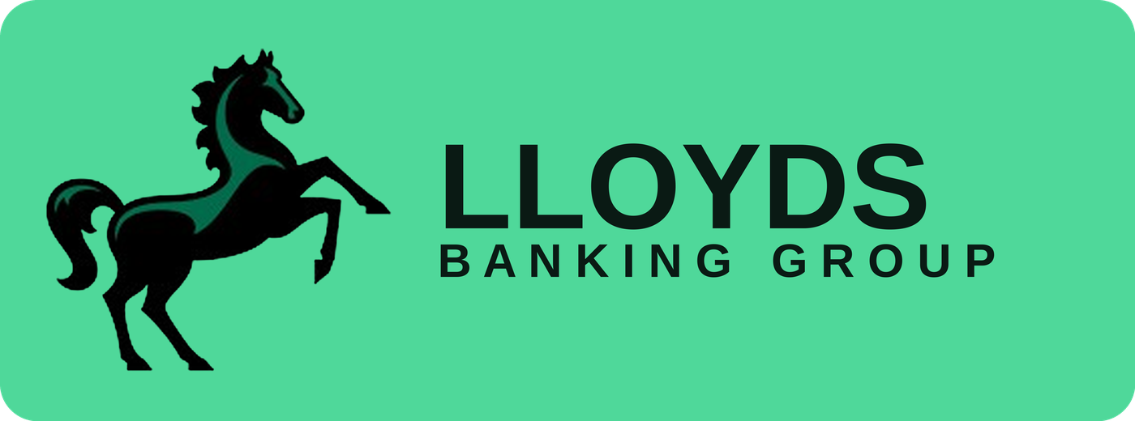
DESIGNATHON 2026
Team: Trust Ledger
Reusable KYC on DLT — Lloyds Technology Centre Designathon 2026
PARTICIPANTS
Saundarya Saurabh
Lakshy Gupta
Sunil Kumar Pandey
Ankit Samadhiya
Sunidhi Singh
Lloyds Technology Centre · Designathon submission · 1 July 2026

Slide 2

LLOYDS
DESIGNATHON 2026
Verify once.
Trust everywhere.
Reusable Identity Across Lloyds Banking Group — a verifiable credential a customer earns once, and every product and institution in the Group can trust.
Hyperledger Fabric
RAFT
Golang
SHA-256 & X.509 Cert
Verifiable Credentials
Lloyds Technology Centre · Designathon submission · 1 July 2026

Slide 3



WHAT WE'RE BUILDING
One identity, reused across every Lloyds Banking Group brand
A customer who verifies their identity once — at Lloyds, Halifax, Bank of Scotland, or MBNA — reuses that same verified identity across every other Group product and institution. The credential travels with the customer; the documents never do.
Verify once
Seal the proof
Trust everywhere in the Group
A customer completes KYC the normal way, one time, with any Group brand.
A tamper-proof fingerprint of that verification is committed to a shared consent ledger.
Any other Lloyds Banking Group product confirms it's genuine in seconds.
48 hours of re-verification, down to about 4 minutes — for every brand under the Lloyds Banking Group umbrella.
01
Notes:
Open here. Lloyds Banking Group owns multiple brands (Lloyds, Halifax, Bank of Scotland, MBNA) — that's the real, immediate use case before any cross-industry ambition.

Slide 4



WHY THIS IS NEEDED
Inside one Group, customers still start from zero
A Lloyds current account holder who applies for a Halifax mortgage or an MBNA credit card still re-submits the same Aadhaar, PAN, and address proof — inside the very same banking group. The friction isn't cross-industry. It starts at home.
Slow, even internally
Duplicated cost
No shared memory
24–48 hours typical, even when the customer already passed KYC at a sister brand.
Each Group brand pays for manual review and third-party checks on the same person.
Lloyds, Halifax, and Bank of Scotland each treat a known customer as new.
Start inside the Group. Extend outward later.
Solving reuse across Lloyds, Halifax, Bank of Scotland, and MBNA is the achievable, immediate win — and it's also the proof of concept for the larger cross-institution network described later in this deck.
02
Notes:
This reframing — internal Group reuse first, cross-industry later — is the more credible, fundable pitch than jumping straight to 'every bank in the UK.'

Slide 5
HOW WE OVERCOME IT
Only a fingerprint travels. The documents never do.
This single design decision is what makes the idea workable. The documents stay exactly where they are, encrypted, with the brand that collected them. Only a one-way cryptographic hash — a fingerprint, not a copy — is what moves between Lloyds, Halifax, Bank of Scotland, and MBNA.
Privacy by construction
No personally identifiable information is ever written to the chain — not a policy choice, an architectural one.
Regulator-viable, not just demo-viable
A shared ledger with PII on it would be a non-starter for compliance. Hash-only is what makes this realistic.
One-way and unique
Change one character in a document and the fingerprint changes completely — and it can never be reversed back into the original.
03
Notes:
If asked 'why not just put everything on chain' — this slide is the answer. Hash-only is the load-bearing design decision in the entire system.

Slide 6
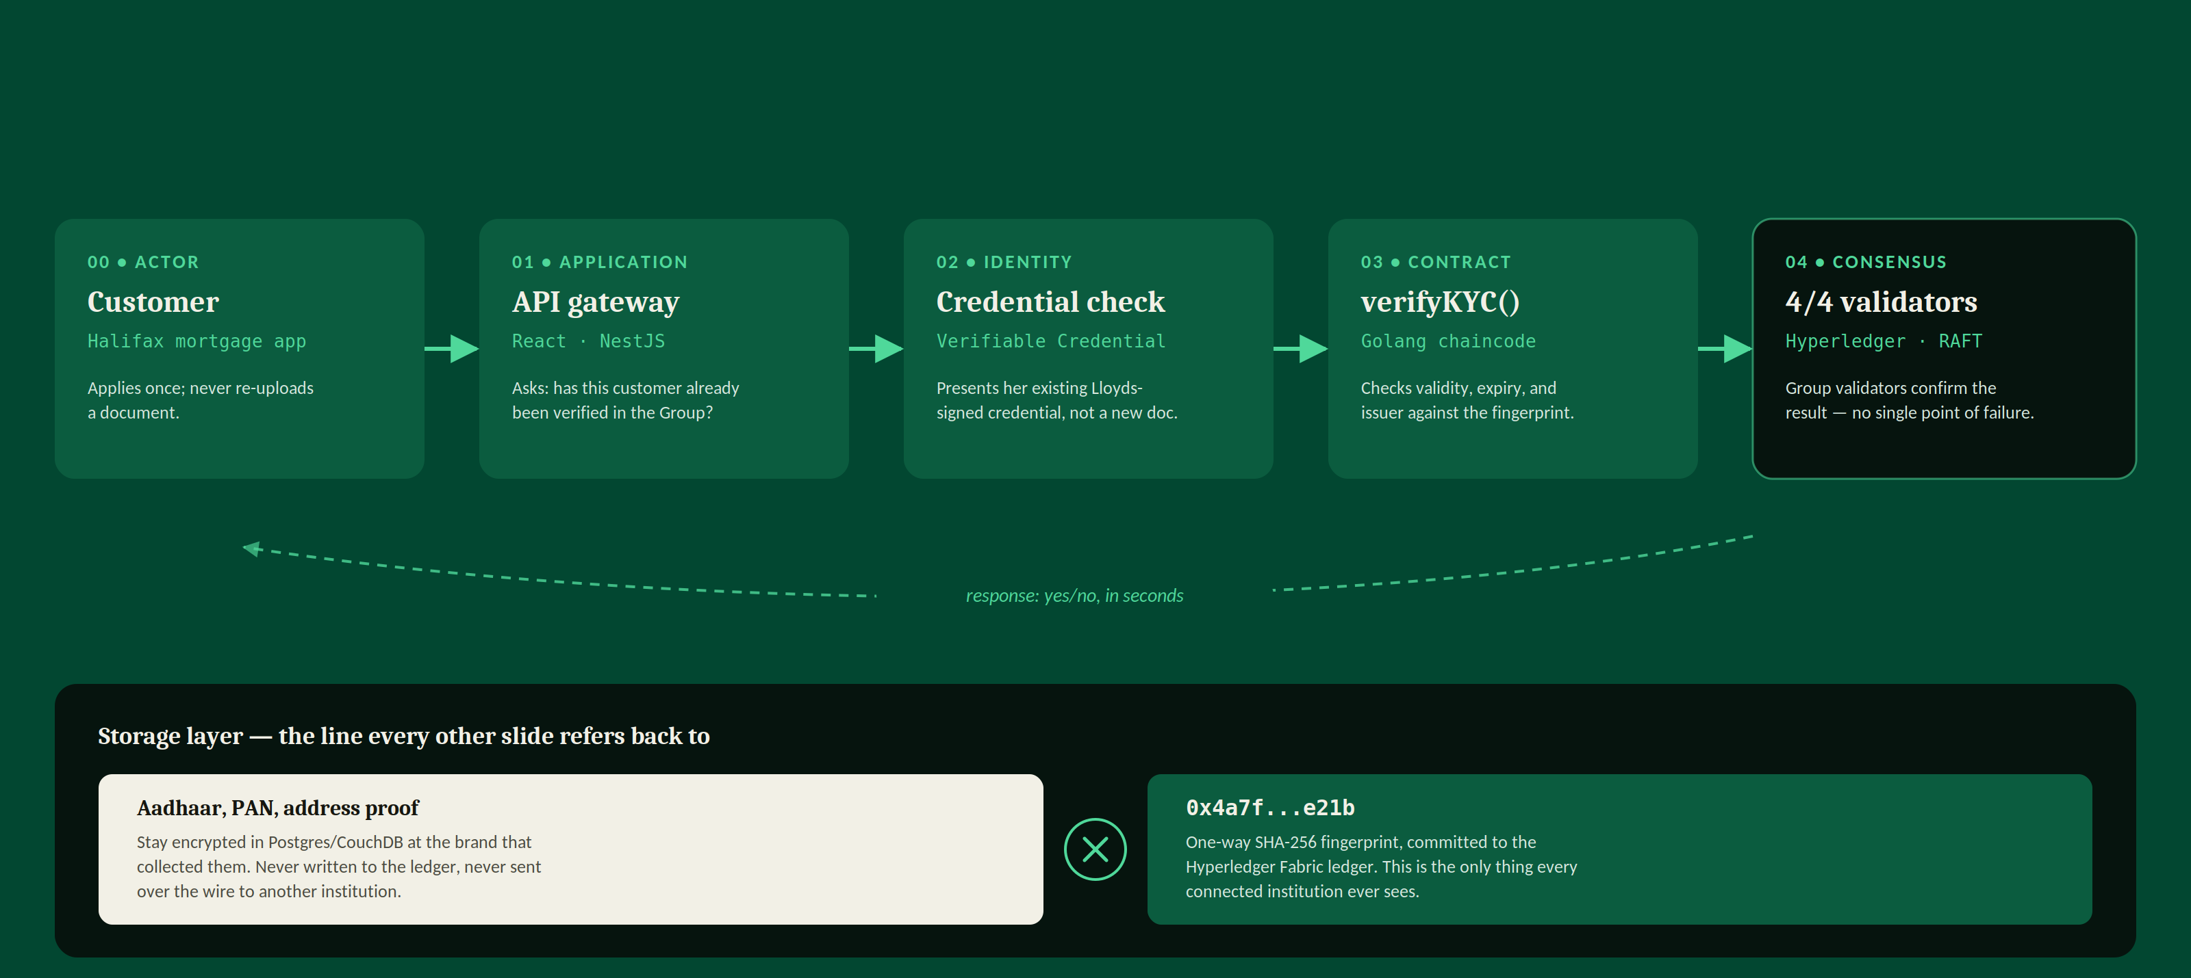
HIGH LEVEL DESIGN
One request, five systems, zero documents in transit
How a single verifyKYC() call actually moves through the stack — request in, confirmation out.
This is the same verifyKYC() call walked through narratively a few slides on, with Priya’s Halifax mortgage — here it’s the system diagram.
06

Slide 7
HOW IT'S STRUCTURED
Five layers, each doing one job well
Application
Dashboards, applications, admin tools — what people touch.
01
React · NestJS API gateway
Identity & credential
Signed, portable proof of who verified what.
02
Verifiable Credentials · DID
Smart contracts
issueKYC, verifyKYC, revokeKYC — trust enforced automatically.
03
Golang
Blockchain / DLT
Permissioned network, multiple validators, no single point of failure.
04
Hyperledger Fabric · RAFT
Storage
On-chain fingerprints, off-chain encrypted records — split by design.
05
Postgres / CouchDB
Documents and PII never appear in this diagram on purpose — only fingerprints move through layers 2 to 5.
07
Notes:
Be ready to point at each lane and name the real technology. If asked which is most novel, layer 2 (identity & credential) is the differentiator — the chain itself (layer 4) is intentionally boring, proven technology.

Slide 8
BEYOND HASH-ONLY
Halifax doesn’t need Priya’s whole credential — just one answer
verifyKYC() can return a single yes/no claim instead of the full credential — the same construction zero-knowledge proofs use, applied to the one question a lender actually has.
TODAY • verifyKYC()
PROPOSED • verifyClaim()
Returns the whole picture
Issuer, issue date, expiry, status — all of it, every time, even when Halifax only needed to know one thing.
Returns one proven claim
Halifax asks one question; the contract proves it’s true without exposing anything else on the credential.
→
issuer: Lloyds
verified: 12 Jun 2026
expiry: 12 Jun 2027
status: active, not revoked
request: verifyClaim(credentialId, "kyc_active")
response: { claim: true, expiresIn: "118d" }
Issuer, exact dates, and document details stay sealed inside the credential.
IF EXPIRED OR REVOKED
response: { claim: false, reason: "not_active" }
No reason beyond pass/fail is ever returned — Halifax can’t infer why.
Same ledger, same validators — the contract layer just answers a narrower question.
06

Slide 9
THE CUSTOMER SIDE
Priya sees the request and decides — every time
Reuse is never silent. This is the actual screen on her phone.
HALIFAX • MORTGAGE APP
Why this matters for adoption
Halifax wants to confirm:
"Your Lloyds KYC is verified and active."
No documents will be shared. Only this credential is checked.
Consent is explicit, not assumed
Reuse never happens silently in the background — the customer approves each new institution's access in the moment.
She sees the claim, never the raw data
The screen states exactly what's being confirmed, in plain language — matching the selective-disclosure claim on the previous slide.
Approve & share claim
Decline
Revocation is one tap, not a phone call
Her consent history lists every institution that's checked her credential, each one individually revocable — this is what revokeKYC() looks like from her side.
Every approval joins her consent history, revocable any time.
CONSENT HISTORY
Halifax • Mortgage
Active
Bank of Scotland • Loan
Revoke
07

Slide 10
THE HLD IN PRACTICE
Walking the architecture through a real customer journey
Priya already holds a Lloyds current account. She now applies for a Halifax mortgage.
1
Application layer
Priya opens a Halifax mortgage application. The front end calls the shared API gateway and asks: has this customer already been verified anywhere in the Group?
Halifax mortgage application
2
Identity & credential layer
Her existing Lloyds-issued Verifiable Credential is presented — a signed, portable proof from when she opened her Lloyds current account, not a fresh document upload.
Lloyds-issued credential
3
Smart contract layer
Halifax's system calls verifyKYC() against that credential's fingerprint. The contract checks validity, expiry, and issuer — Lloyds — automatically.
verifyKYC() on Priya's credential
4
Blockchain / DLT layer
The check is confirmed across the Group's permissioned validators. Halifax now trusts the result without ever requesting Priya's Aadhaar or address proof again.
4/4 Group validators confirm
5
Storage layer
Priya's mortgage documents remain in Halifax's encrypted off-chain store. Only the credential's fingerprint was ever written to the shared ledger.
Hash on-chain, documents stay off
Outcome: Priya's Halifax mortgage moves to underwriting in minutes — her identity, not her paperwork, did the work.
08
Notes:
This slide exists specifically because the team asked for the HLD to be walked through with a concrete scenario, not just shown as an abstract diagram. Keep the example bank-centric and Group-specific — Lloyds to Halifax is more credible to this panel than a generic 'Bank A to Bank B' example.

Slide 11
HOW IT ACTUALLY RUNS
Three functions, plus one on the roadmap
issueKYC()
Consensus before anything is final
Lloyds commits the credential's fingerprint after verification.
verifyKYC()
Any Group brand checks validity and gets a yes/no in seconds.
verifyClaim()
Proposed extension: proves one narrow claim, the selective-disclosure idea shown earlier, made real.
revokeKYC()
A compromised credential is invalidated network-wide, instantly.
09
Notes:
Two small live visuals here: the hash literally resolving (bottom left) and 4 validators confirming in sequence (right). If asked about consensus by name, it's IBFT — Istanbul Byzantine Fault Tolerant — already used in enterprise Besu/Quorum deployments.

Slide 12
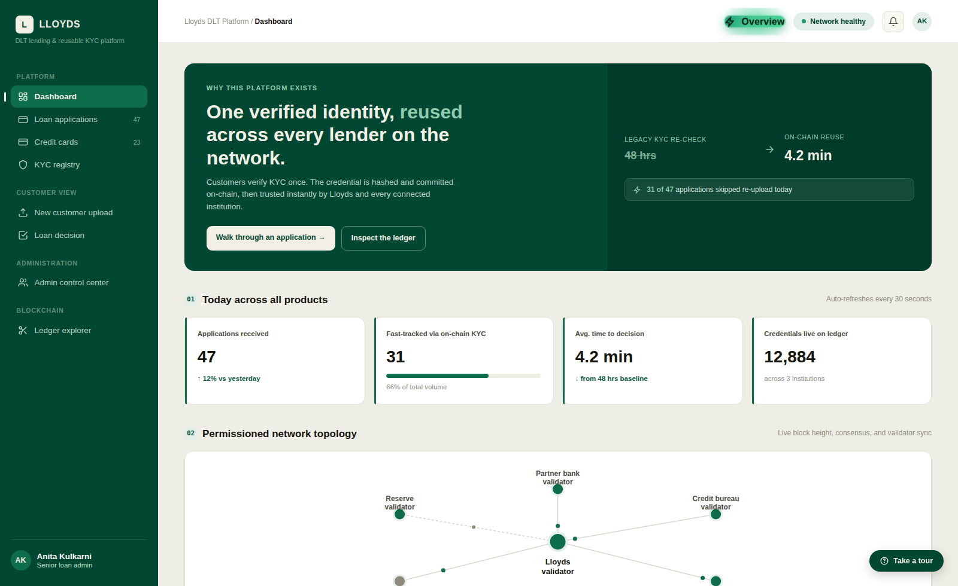
THE PRODUCT, LIVE
Every product line, one reusable KYC engine
Not a mockup — this is the real, running dashboard.
View live prototype →
What this shows
Personal loans, home loans, vehicle loans, business loans, and cards all run through the same credential
66% of today's applications skip document re-upload entirely
The validator network — Lloyds, a Group brand, a credit bureau, a regulator — is visibly in sync
10

Slide 13
WHAT WE CAN TAKE FURTHER
Today it's the Lloyds Banking Group. The design already assumes more.
Nothing about the architecture is single-bank. Every new validator — another bank, an NBFC, a fintech — is just one more node trusting the same rules.
Scales without redesign
RAFT consensus adds validators horizontally; issueKYC / verifyKYC / revokeKYC don't change per product or per institution.
A shared fraud signal
A revoked credential is visible to every connected institution at once — not siloed, the way it is today.
Lower cost, industry-wide
Every institution on the network saves the cost of re-verifying something already cryptographically proven.
11
Notes:
Frame this as 'designed to extend,' not 'promised to deliver' — it's a roadmap slide, and should read as one if asked directly.

Slide 14
LLOYDS
This isn't a faster form.
It's a trust layer the entire lending industry can finally share.
Thank you — questions welcome.
12
Notes:
Three things worth defending hardest if questions run long: (1) documents never touch the chain, only hashes; (2) a human still makes the final loan decision, the contract only informs it; (3) this is designed to extend beyond Lloyds into a shared industry network, not a closed system.

